Slide 1
NEURON SIMULATION
Swagmaster Jeff
Department Course Number Section Time Location
2025 April 04
The purpose of this slideshow is to demystify the utter insanity of my work. Enjoy!

Slide 2
Swagmaster Jeff
Department Course Number Section Time Location
April 04 2025
FLOWCHART
NEURON STRUCTURE
NEURAL CIRCUIT
SIGNALING

Slide 3
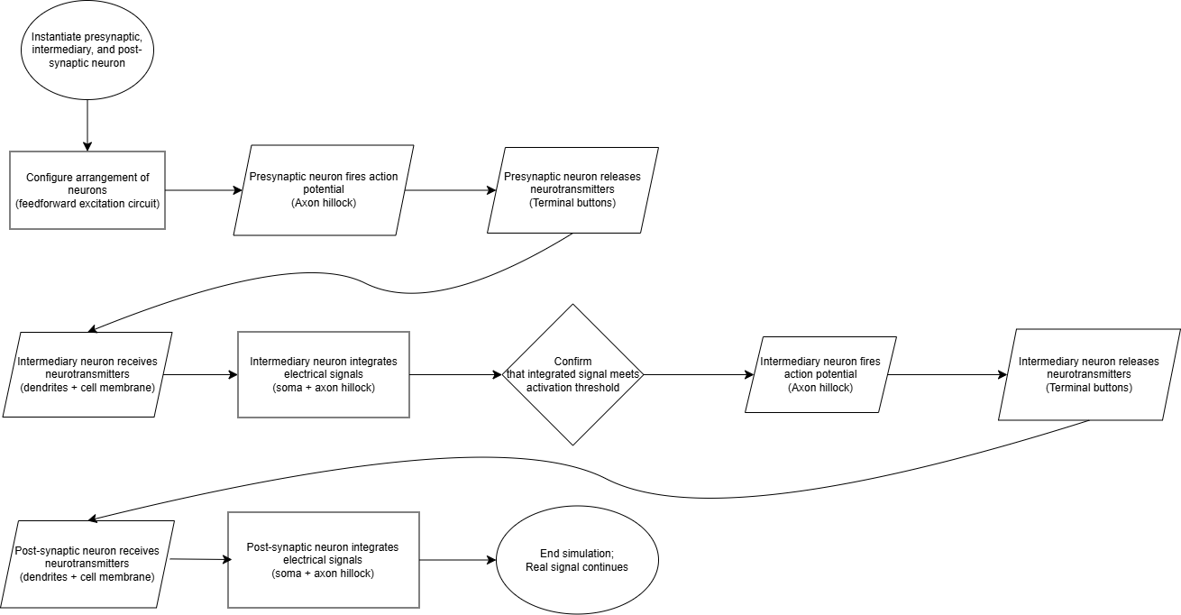
FLOWCHART
Swagmaster Jeff
Department Course Number Section Time Location
April 04 2025
Notes:
Spend 5 minutes delivering a broad overview of the entire simulation

Slide 4
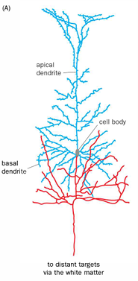
NEURON STRUCTURE
Swagmaster Jeff
Department Course Number Section Time Location
April 04 2025
Key Properties
Apical dendrite: a single dendrite at the top of the neuron
Basal dendrites: dendrites that extend from the bottom of the neuron
Multi-branch axon: a single axon with multiple branches that allow for multiple connections to other neurons
Notes:
Highlight the fact that signals generally flow from dendrites, to the soma, to the axon, to the terminal buttons

Slide 5
Swagmaster Jeff
Department Course Number Section Time Location
April 04 2025
The pyramidal cell has been implemented as a class with an estimated completion of 65%. More properties are being added, such as Nernst equilibrium and the Hodgkin-Huxley model.

Slide 6
FLOWCHART
Swagmaster Jeff
Department Course Number Section Time Location
April 04 2025
Notes:
Spend 5 minutes delivering a broad overview of the entire simulation

Slide 7
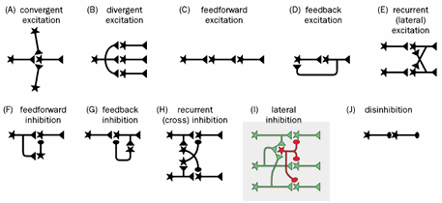
KNOWN NEURAL CIRCUIT CONFIGURATIONS
Swagmaster Jeff
Department Course Number Section Time Location
April 04 2025
Neural circuits fall in one of two categories: excitatory or inhibitory.
Note
Future work would aim to implement all other configurations. How exciting!

Slide 8
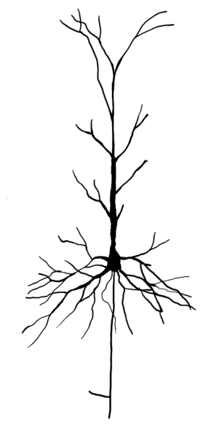
NEURON CONFIGURATION
Swagmaster Jeff
Department Course Number Section Time Location
April 04 2025
Initial
Intermediary
Terminal
Generates original signal at beginning of simulation
Receives original signal, integrates it, fires an action potential, then releases neurotransmitters
Receives original signal; simulation ends

Slide 9
Swagmaster Jeff
Department Course Number Section Time Location
April 04 2025
Implementation of all known neural circuits is perhaps the most difficult aspect of this project at this time. I would like to ask you for your help and guidance with this segment.

Slide 10
FLOWCHART
Swagmaster Jeff
Department Course Number Section Time Location
April 04 2025
Notes:
Spend 5 minutes delivering a broad overview of the entire simulation

Slide 11
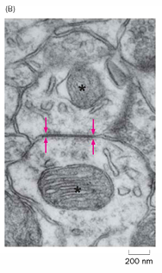
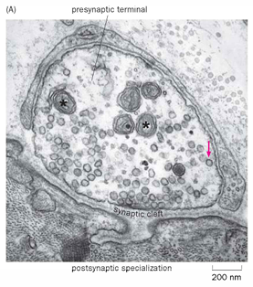
NEURON SIGNALING
Swagmaster Jeff
Department Course Number Section Time Location
April 04 2025
CHEMICAL SYNAPSE
ELECTRICAL SYNAPSE

Slide 12
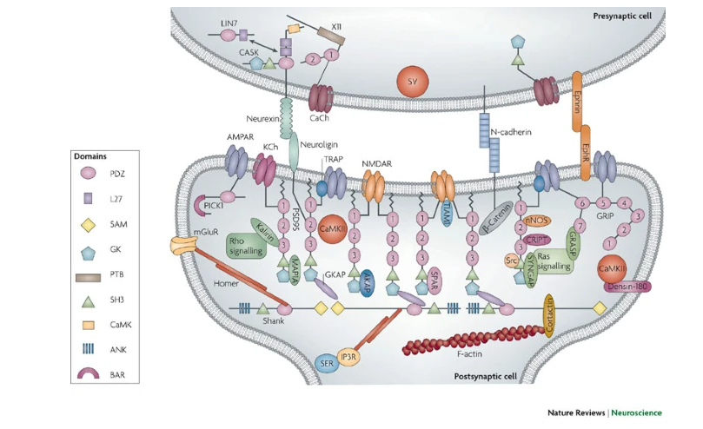
CHEMICAL SYNAPSES
Name
Department Course Number Section Time Location
DATE
A CLOSER LOOK
Glutamate & GABA are the primary neurotransmitters that are responsible for neuron activation and deactivation
Sodium & Potassium are the primary ions that will be accounted for in the simulation

Slide 13
Swagmaster Jeff
Department Course Number Section Time Location
April 04 2025
A successful simulation will model the movement of ions from one neuron to another, as well as the changes in membrane potential that it causes.

Slide 14
Contact Me
Swagmaster Jeff
Department Course Number Section Time Location
DATE
Email
jromero121@go.pasadena.edu
Feel free to send me articles on neuroscience or computer programming!
Phone
(213) 915-2412
Discord
j.dawg1

